Slide 1
Present simple

Slide 2
This tense is used:
When an action is always true
Moon goes around the earth in 28 days.
For habits and routines,
I always have breakfast at home
Likes and dislike
The company prefers working with relible employees rather than workers with good sense of homour.

Slide 3

Present simple with I, you, we, they
Affirmative
The verb does not change
I carry
You carry
We carry
They carry
I always carry my mobile in my handbag.

Slide 4
Negative
“do not = don’t" is used as an auxiliary
I do not = I don’t carry
You do not = You don’t carry
We do not = You don’t carry
They do not = don’t carry
Farmers don’t carry their crops at midday. The sun burns at this time of the day.
Questions
“Do” is used as an auxiliary
Do I carry?
Do you carry?
Do we carry?
Do they carry?
Do people carry water in buckets in your country?

Slide 5
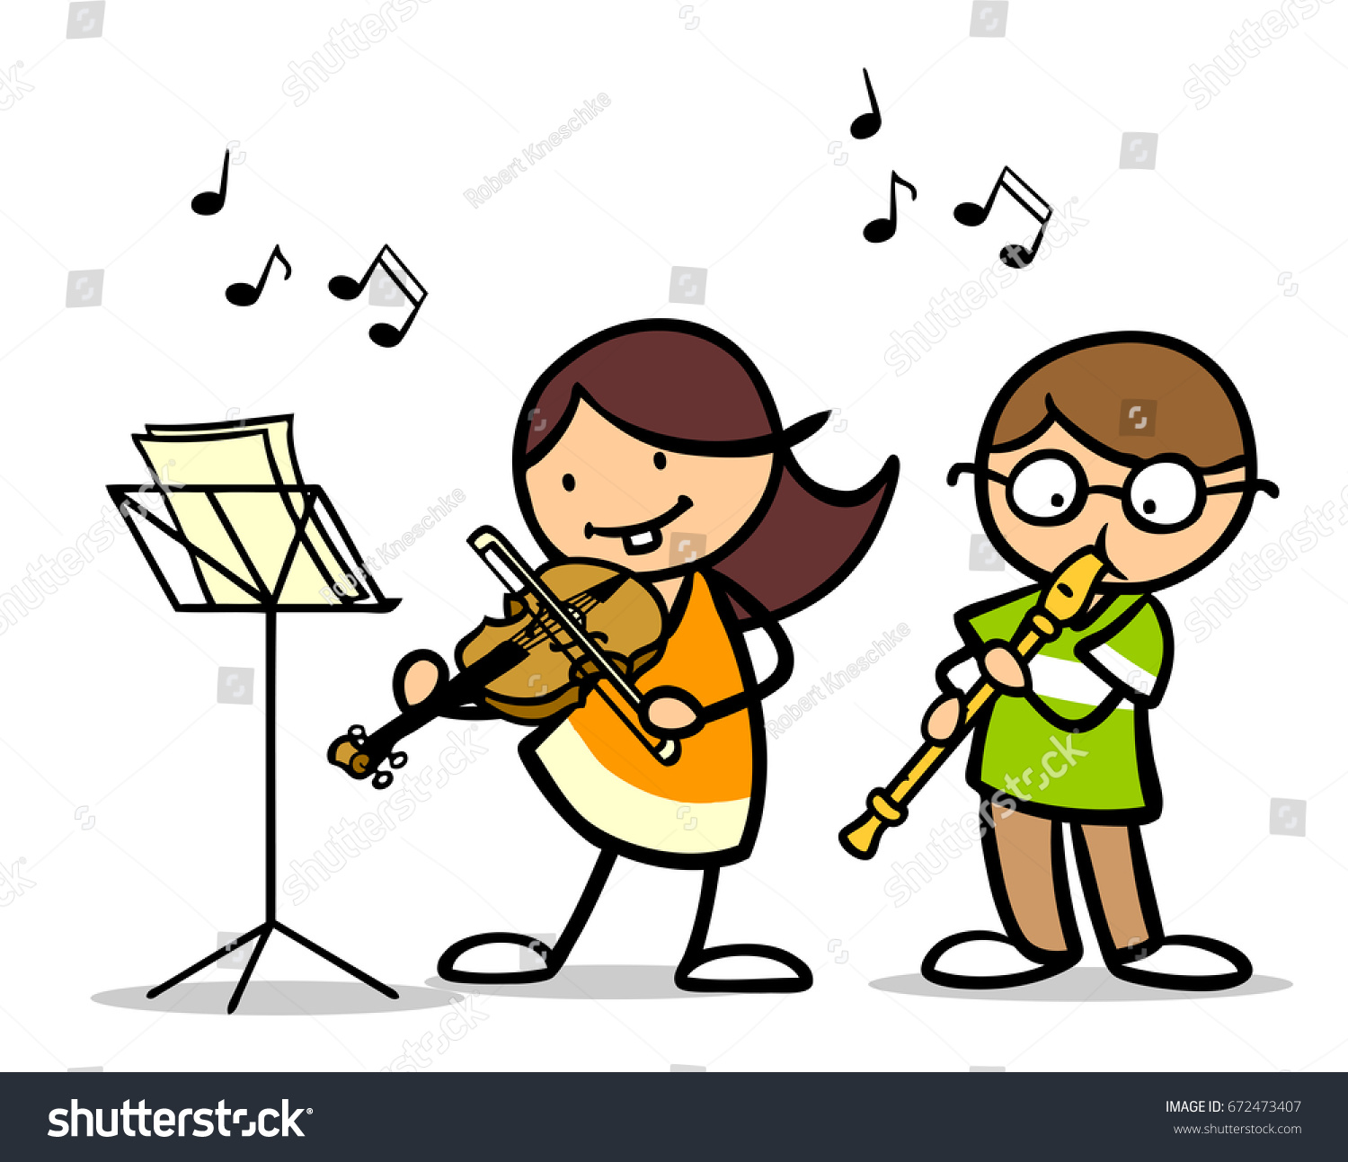
Present simple with he, she, it
Affirmative sentences
An “s” is added to the verb
He plays
She plays
It plays
She plays the violin at nights.

Slide 6
Exception
When the verb ends in an “s” sound, ”es” is added to the verb.
address – addresses
wash – washes
watch – watches
relax – relaxes
And verbs ending in “o”
Go – goes
Do – does
With the third person, ”have” turns into “has”
He has - she has -- it has
However, if the verbs ends in ”y” the ending is “ies”.
try – tries
carry – carries
cry – cries
He relaxes with the scenery of open apaces.
It goes everywhere.
An octopus has nine brains.
Every time she sees you, she cries.

Slide 7
Negative
“does not = doesn’t" is used as an auxiliary
She does not = She doesn’t wash
He does not = He doesn’t wash
It does not = It doesn’t wash
The verb does not change as the third person is shown in “does”. The verb does NOT need the “s”
Marian doesn’t pronounce properly because she has brackets.
Questions
“Does” is used as an auxiliary
Does she wash?
Does he wash?
Does it wash?
The verb does not change as the third person is shown in “does”. The verb does NOT need the “s”
How many stomachs does a camel have?

Slide 8
This tense commonly uses adverbs of frequency or phases of frequency showing how often an action is done.
Frequency adverbs– usually placed before the verb - except verb to be.
always, almost always, constantly, normally, frequently, usually, occasionally, rarely, barely, hardly ever, never.
Her fiancé’s mother constantly talks about her daughter’s success.
Phrases of frequency – placed at the beginning or at the end of the sentence.
Every day, every week, every year and so on, in the morning in the afternoon, in the evening, at night, once a day, twice a week, three times a year (and the possible combinations) .
Every week, their son, an only child, visits his cousins to have fun.

Slide 9
Present continuous

Slide 10
Usage
Actions at the moment of speaking
People involved in this parade are wearing sparkly costumes.
Actions in the current period of time
Who are you working for right now?
To describe photos, pictures, paintings, images
In the photo, people are celebrating their annual Festival.
To describe changes
The weather is becoming mild. It was chilly, but now it is improving

Slide 11
We use the verb “to be” + a verb ending in “ing”
is explaining are climbing am cleaning
Some exceptions
With one-syllable verbs ending in consonant + vowel + consonant, we double the last consonant
run – running swim – swimming
With sentences in active voice, every time a main verb is next to verb “be”, it must end in “ing”.
X The planet is suffer the consequences of the green house effect.
X. The planet suffering the consequences of the green house effect.
The planet is suffering the consequences of the green house effect.

Slide 12

AFFIRMATIVE
I am searching
You are searching
He is searching
It is searching
We are searching
They are searching
Politician are searching how to convince more electors.

Slide 13
I am not = I’m not searching
You are not = You’re not = You aren’t searching
He is not = he’s not = he isn’t searching
She is not = she’s not = she isn’t searching
It is not = It’s not = it isn’t searching
We are not = we’re not = we aren’t searching
They are not = they’re not = they aren’t searching
The dog is not searching in the ground. It is hiding a bone.
Am I searching?
Are you searching?
Is he searching?
Is she searching?
Is it searching?
Are we searching?
Are they searching?
Is that explorer searching anything on Internet?

Slide 14
Some time references can be used to show the present context - such as:
right now, at present, now, nowadays, today, at the moment, today, tonight, this (week, year, day, morning) and so on.
Nowadays, I am living on the ground floor, but I’d like to moved into a higher floor. It could be terribly noisy at nights and very early.
“Nowadays” is the present reference.
“I am living” is the present continuous.

